Slide 1
Boosting Algorithms

Slide 2
Definition
Boosting is a general method of combining multiple weak learners into a strong learner. A weak learner is a model that performs slightly better than random guessing, while a strong learner is a model that can achieve high accuracy and generalization.
It works by iteratively adding weak learners to the ensemble, and adjusting their weights based on their errors. The final prediction is made by a weighted vote of the weak learners

Slide 3
Adaboost (Adaptive Boosting):
Here for a given dataset, For eg: x1, x2, x3, y. We distribute the sample weight for each instance equally. Then find the best tree/model among the features x1,x2,x3 and do prediction, when we get the errors , we calculate the revised weights then modify the existing dataset and repeat the process. Finally, the best by majority voting of all the models is taken as the output.

Slide 4
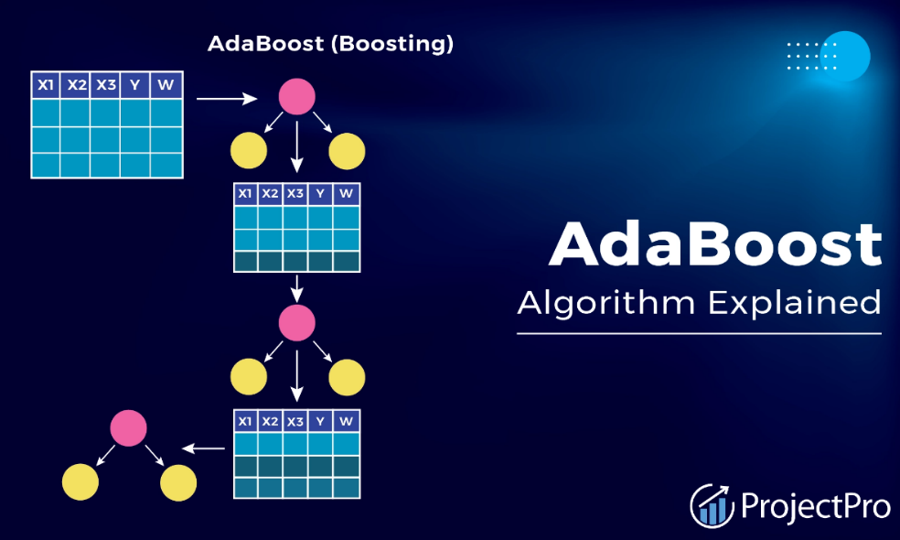
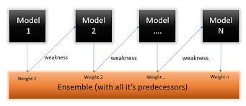
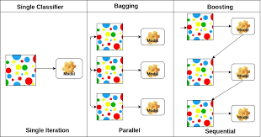

Slide 5
XG Boosting
XGBoost, short for extreme gradient boosting, is a more advanced and efficient version of gradient boosting. XGBoost uses decision trees as the base learners, and updates their weights in each iteration based on the gradient descent algorithm.
The main advantages of XGBoost are its scalability, speed, and regularization. XGBoost can handle large-scale data, parallelize computations, and prevent overfitting

Slide 6
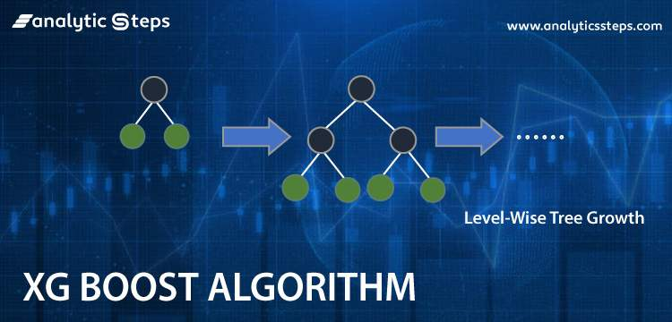

Slide 7
LG Boosting
LightGBM, short for light gradient boosting machine, is a newer and faster variant of gradient boosting and has also gained popularity in machine learning challenges and scenarios. LightGBM uses decision trees as the base learners, and updates their weights in each iteration based on the gradient descent algorithm.
The main differences of LightGBM from XGBoost are its leaf-wise tree growth strategy, its exclusive feature bundling technique, and its lower memory consumption. LightGBM can achieve higher accuracy and efficiency than XGBoost.

Slide 8
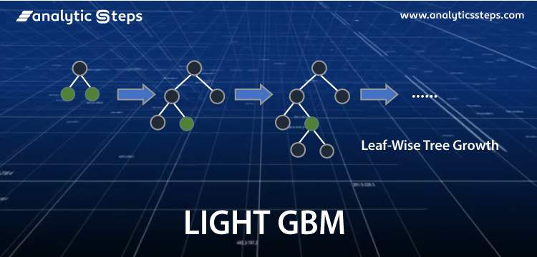
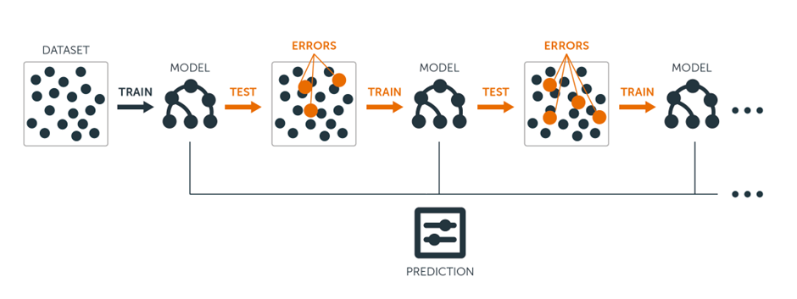

Slide 9
Summary
Generally speaking, AdaBoost is a good option for smaller or medium-sized datasets due to its simplicity and interpretability. For larger or more complex datasets, XGBoost or LightGBM are recommended for their scalability and efficiency.
Those who prioritize accuracy and speed should go for LightGBM for its leaf-wise tree growth and feature bundling. On the other hand, XGBoost is better for regularization and stability due to its shrinkage and subsampling.

